Slide 1

Microsoft Graph 201
Jan Vidar Elven
Microsoft Enterprise Mobility MVP
@skillriver | gotoguy.blog
Notes:
If you know a few things about Microsoft Graph, and wonder what to do next and how you can use it, this session will give you some great ideas on how to start using the Microsoft Graph in your own solutions.

Slide 2
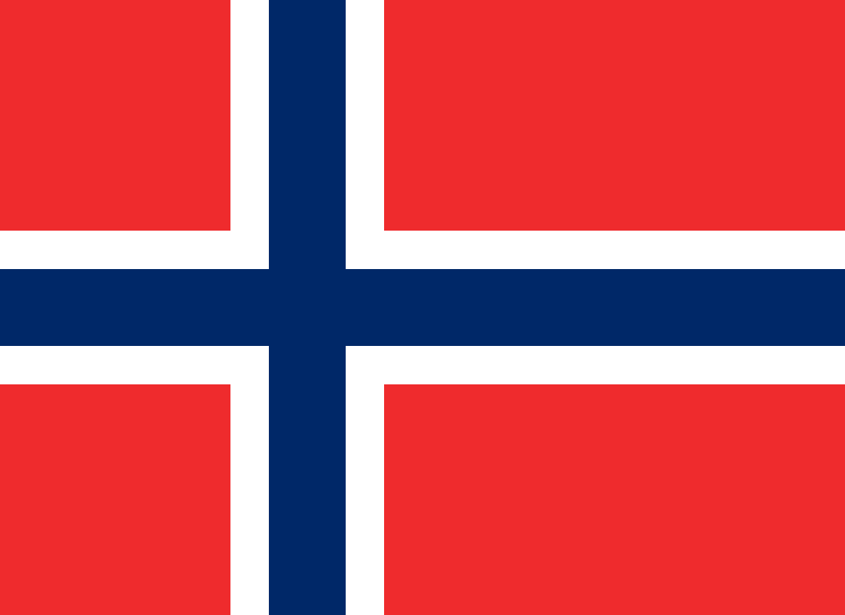
Jan Vidar Elven
Enterprise Mobility MVP
Cloud Architect @ Skill AS
@skillriver | gotoguy.blog

Slide 3
Microsoft Graph
What’s in it for me?

Slide 4




Microsoft Graph
DEVICES
SECURITY ALERTS
PARTNER
THREAT INTELLIGENCE
ORGANIZATION
INSIGHTS
ME
ROLES
ADMIN UNITS
CONTENT
ORGANIZATION
REPORTS
GROUPS
USERS
USERS
APPS
CONTACTS
EMAIL
PEOPLE
TEAMS
DOCUMENTS
SITES

Slide 5
Microsoft Graph API
Access user, group, devices, apps and organizational data
One endpoint
One token
All users
Your app
https://graph.microsoft.com
Users
Groups
SharePoint
Outlook
OneNote
Planner
Teams
Excel
Intune
Azure AD
more…

Slide 6
Calling the API
https://graph.microsoft.com
/{version}
/{resource}
/{id}
/{property}
?{query-parameters}
HTTP verbs dictate the request intent: GET | POST | PATCH | PUT | DELETE
Version: /v1.0 or /beta
Resource: /users, /groups, /sites, /drives, /devices, more…
Member from collection: /users/jan.vidar@elven.no
Property: /users/jan.vidar@elven.no/department
Traverse to related resources via navigations: /users/jan.vidar@elven.no/registereddevices
Query parameters: /users/jan.vidar@elven.no/registereddevices?$top=5
Format results: $select | $orderby
Control results: $filter | $expand
Paging: $top | $skip | $skiptoken

Slide 7

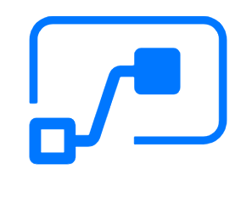

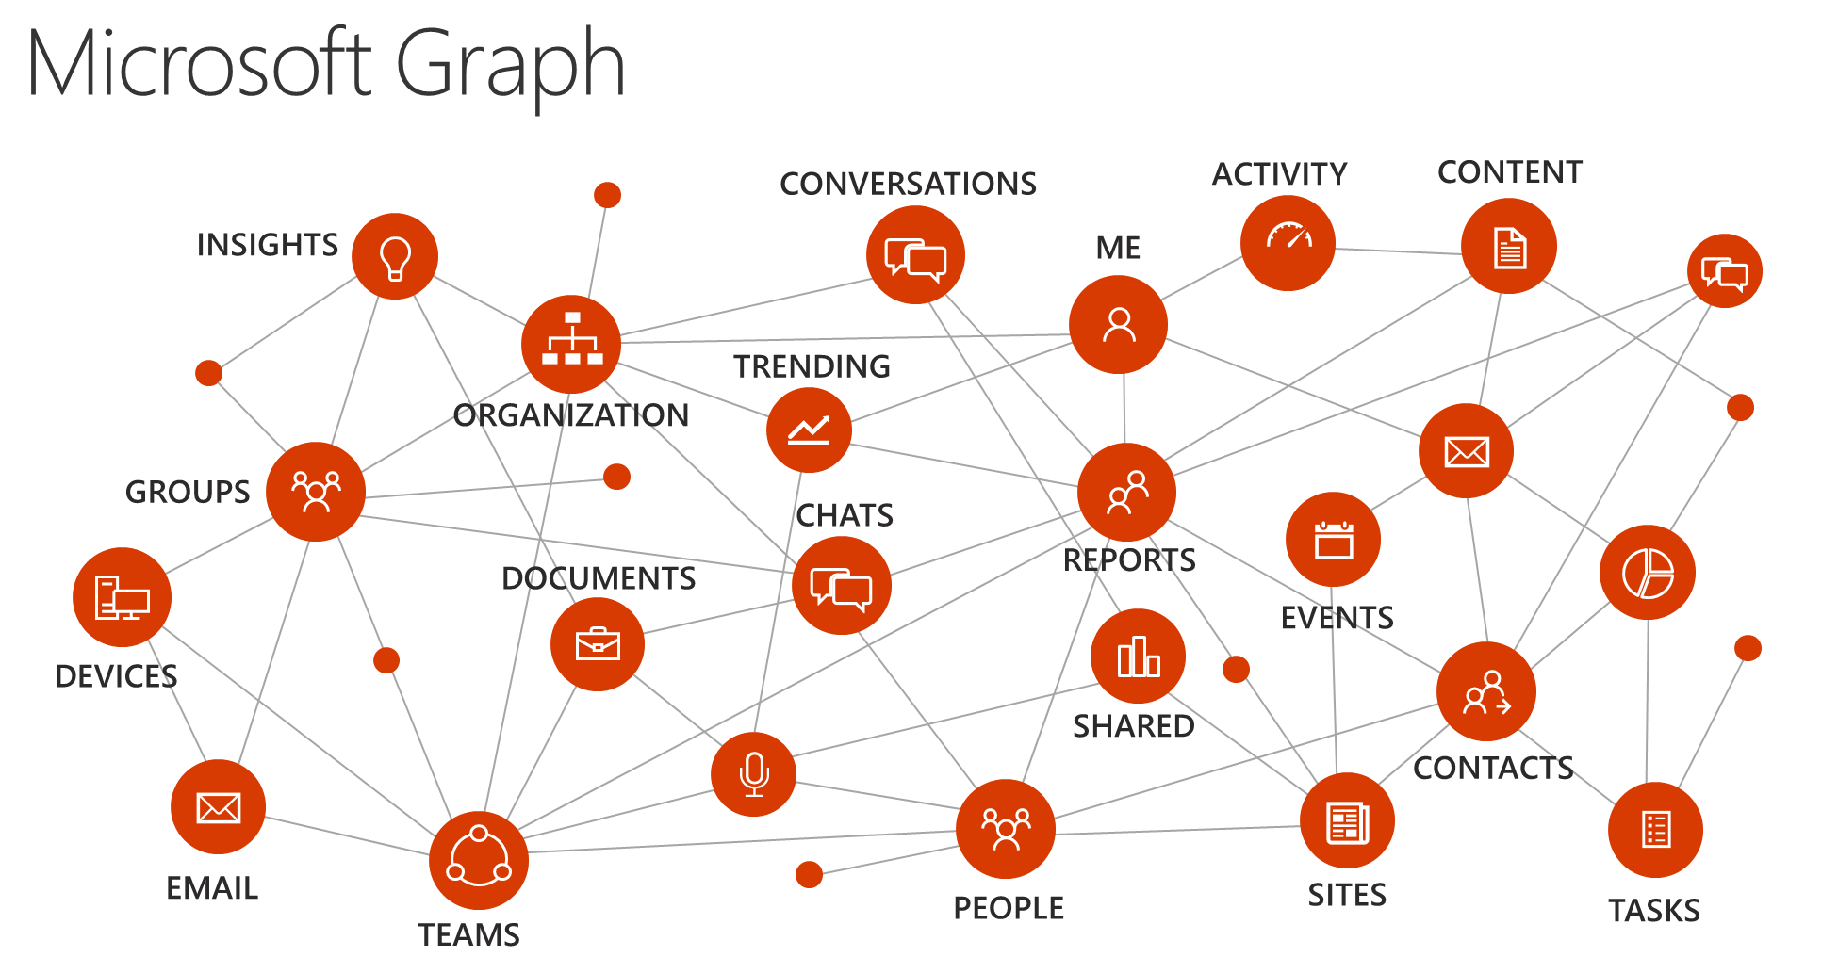


Serverless Apps with Microsoft Graph
PowerApps
Flow
Logic Apps
PowerShell
Azure Functions

Slide 8
To Code or Not to Code?
That’s the question for IT pro’s

Slide 9
Apps and Workflows with no code!
Web.powerapps.com
Flow.microsoft.com
Logic Apps in Azure
If code: Azure Functions

Slide 10
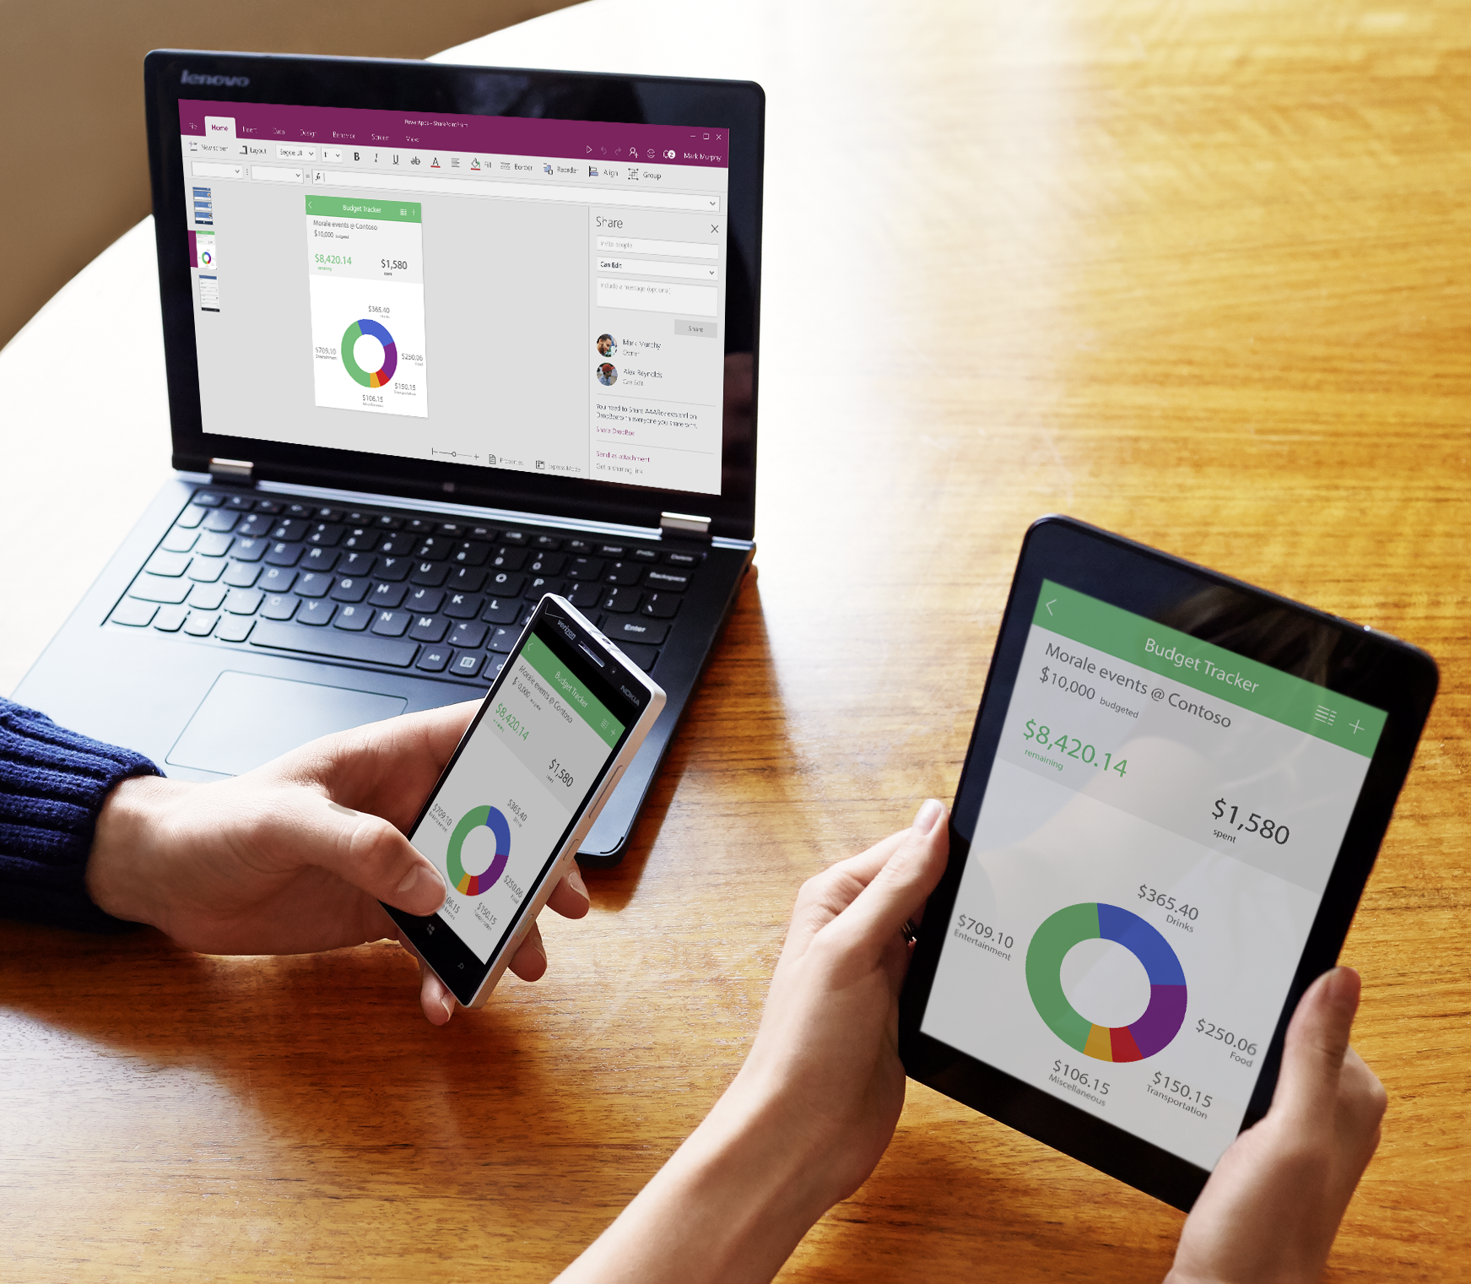
PowerApps
Simple way to create Apps
Works on all platforms
Integrates with ”everything”
“Disposable apps”

Slide 11
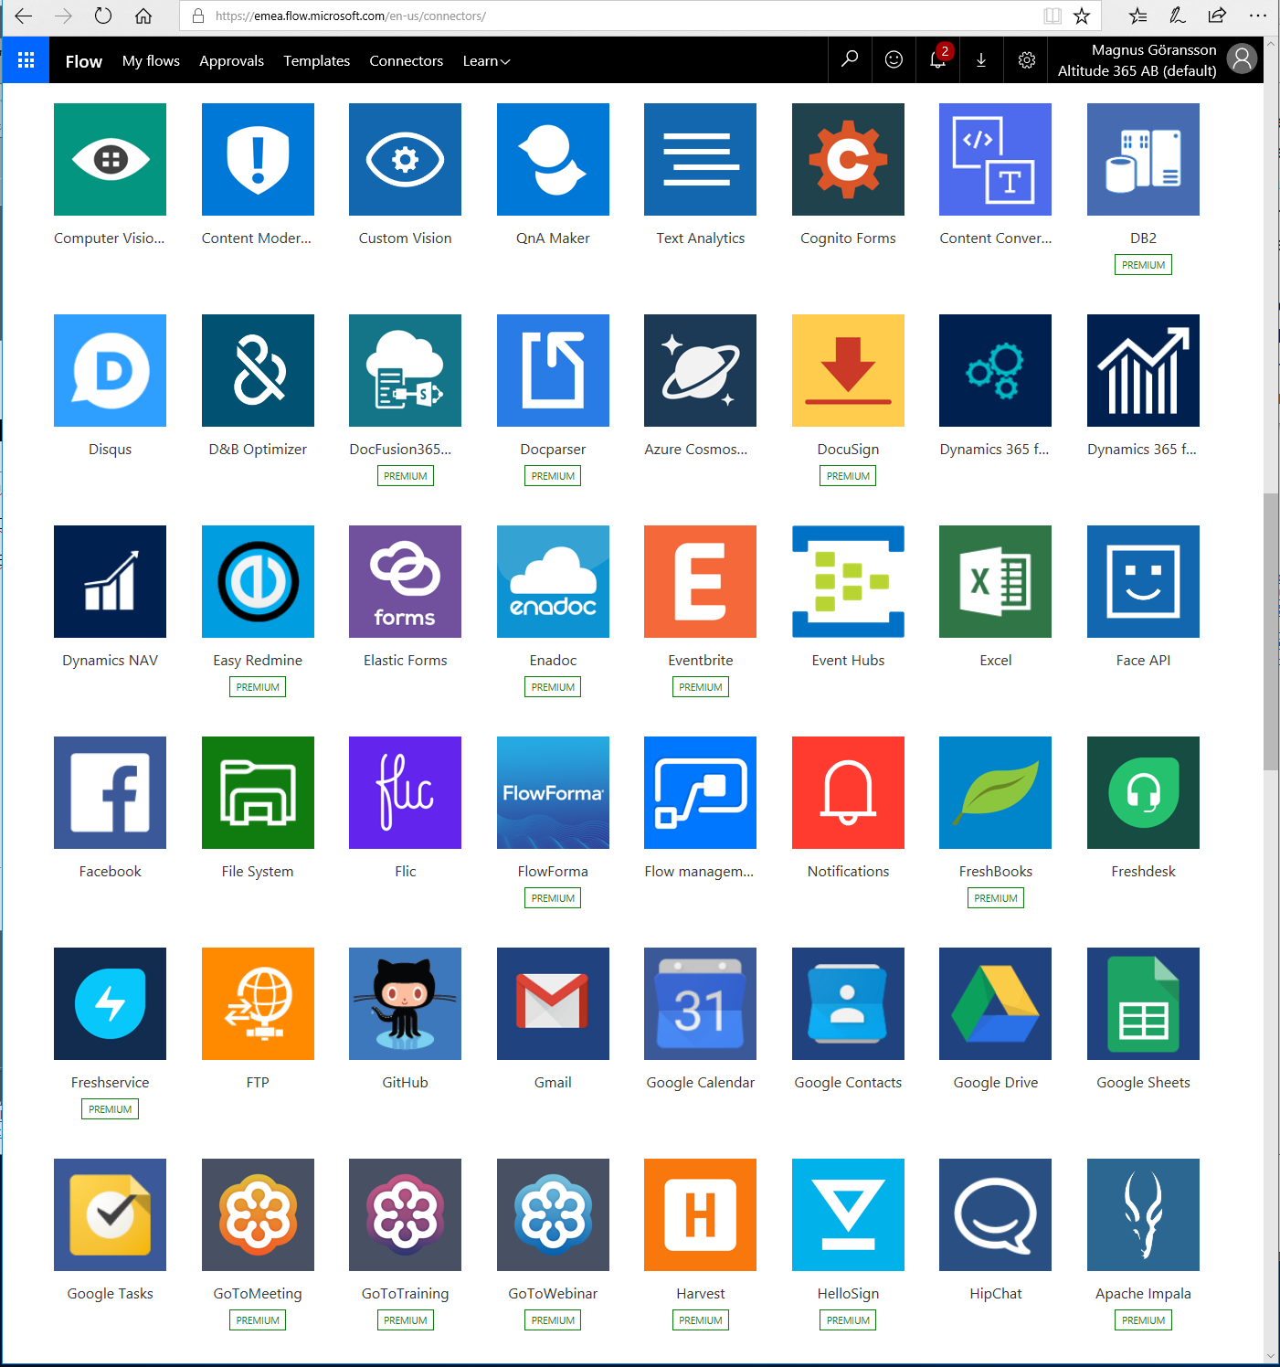
Microsoft Flow
Flows connected to users or groups/teams
“Everyone” can create Flow’s
170 + connectors
Rest/JSON for custom connectors
100s of templates
Gateway to on-prem
Your imagination sets the rules
Mobile client
Export to…

Slide 12
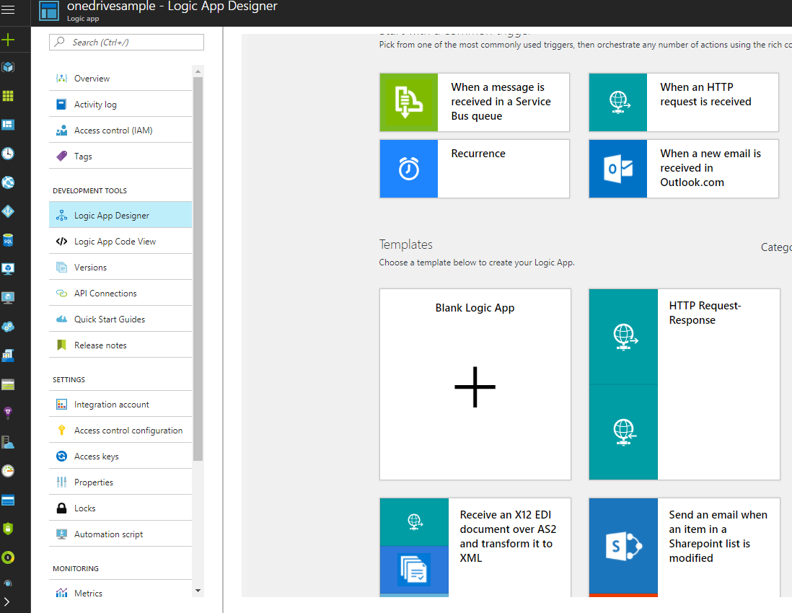
Azure Logic Apps
Looks and feels a lot like Flow
Flows can be imported
The same connectors
But possible to customize more and create more advanced flows
Created in Azure by “Admins”

Slide 13
PowerApps & Microsoft Graph
DEMO

Slide 14

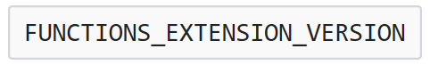
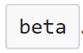
Azure Functions Microsoft Graph Bindings
Available through binding extensions
Azure Functions 2.0 preview:
Ref: https://docs.microsoft.com/en-us/azure/azure-functions/functions-bindings-microsoft-graph

Slide 15













Thank You!
Gold
Silver
Conference Partner

